Slide 1
IoT-Based Smart Patient Turning
& Bed Monitoring System
for Bedridden Patients
Course: IOT Laboratory (CSE-460) | 4th Year 2nd Semester | Jahangirnagar University
Md Khaled Mahmud Jon | Shah Sultan | Abdullah Nazmus-Sakib
Supervised by: Dr. Md. Ezharul Islam & Samsun Nahar Khandakar | Date: 26/07/2026
ESP32
IoT Cloud
Pressure Sensors
Real-Time Alerts
DHT22

Slide 2




Problem Statement
Abstract: Bedridden patients are highly vulnerable to pressure ulcers (bed sores) due to prolonged immobility. Continuous manual monitoring is often inefficient and prone to delay. This project proposes an IoT-Based Smart Patient Turning and Bed Monitoring System that continuously monitors patient body pressure, temperature, and humidity conditions, detecting prolonged immobility and generating alerts to prevent pressure ulcers.
Manual Monitoring
Pressure Ulcers
Time-consuming & prone to delays in patient repositioning
Delayed detection leads to serious health complications
No Real-Time Alerts
Caregiver Overload
Absence of automated remote monitoring systems
High dependency on manual caregiver observation

Slide 3



Objectives
01
Design a pressure monitoring system for bedridden patients
02
Track patient immobility duration and detect prolonged stillness
03
Develop an IoT-based automated alert system
04
Send real-time notifications to caregivers via mobile app
05
Implement cloud-based data storage and remote monitoring

Slide 4
Literature Review
IoT-based healthcare systems enable real-time patient monitoring using sensors, microcontrollers, and cloud platforms.
01
02
Existing smart healthcare solutions mainly monitor body temperature, heart rate, SpO₂, and patient posture using pressure sensors.
Current systems have limitations, including limited pressure monitoring, lack of time-based position alerts, and no environmental sensing integration.
03
04
Most existing solutions also provide limited remote monitoring features and can be costly for widespread healthcare use
05
Our proposed system integrates ESP32, FSR pressure sensors, DHT22, cloud storage, and mobile alerts into a single low-cost platform for continuous patient monitoring.

Slide 5


System Overview
Sensor Unit
ESP32 MCU
IoT Cloud
Alert System
FSR Pressure Sensors + DHT22 Temp & Humidity
Processing Unit - collects & processes sensor data
Firebase / Blynk for data storage & remote access
Buzzer (local) + Mobile Notifications (remote)
System Data Flow: Sensors → Processing → Cloud → Alerts
Alert triggers when patient remains immobile for 2–3 hours | Buzzer activates locally | Mobile push notification to caregiver

Slide 6

Methodology
Step 1
Data Collection:
FSR/Load Cell sensors detect body pressure distribution. DHT22 measures temperature & humidity in real-time.
Step 2
Data Processing:
ESP32 microcontroller collects and processes sensor data. System tracks duration of patient immobility.
Step 3
Decision Making:
If patient remains in same position for 2–3 hours, an alert is triggered automatically.
Step 4
Alert Generation:
Buzzer activates locally. Mobile application sends push notification to caregivers.
Step 5
Cloud Integration:
Data is uploaded to Firebase or Blynk cloud for remote monitoring and historical tracking.

Slide 7
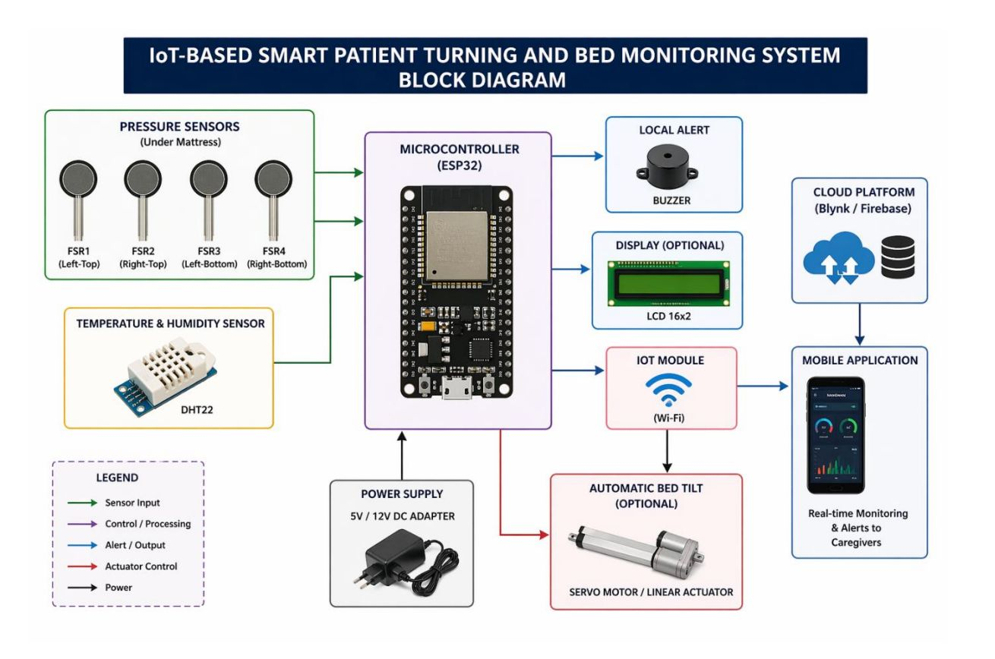
System Design – Block Diagram
PRESSURE SENSORS
D2
Temp & Humidity
5V/12V
Power

Slide 8
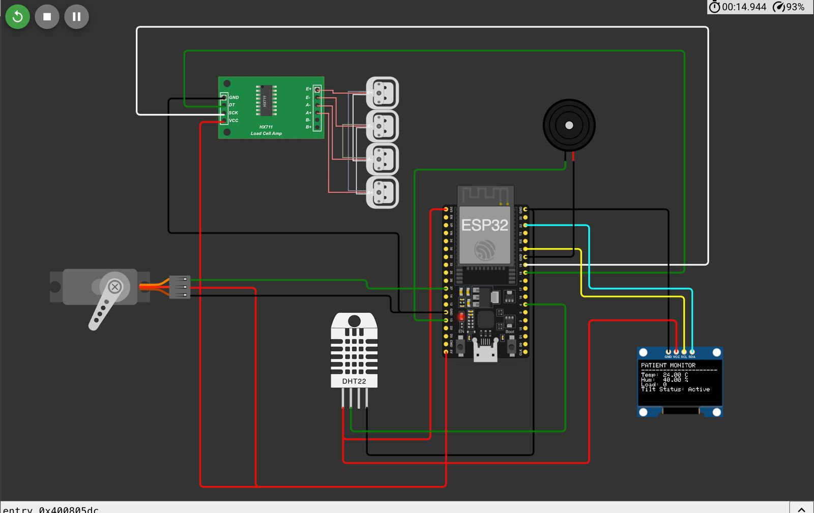
Circuit Diagram

Slide 9
Implementation Planed
🔧 Hardware Components
💻 Software Tools
ESP32 Development Board
Arduino IDE
FSR / Load Cell Sensors (x4)
Firmware development for ESP32
HX711 Load Cell Amplifier
Firebase
Cloud database & real-time sync
DHT22 Temperature & Humidity Sensor
Blynk IoT Platform
Buzzer Module
Mobile dashboard & alerts
LED for displaying Summary
Wokwi Simulator
Servo Motor (Optional Bed Tilt)
Online ESP32 circuit simulation
5V / 12V DC Power Supply
Proteus (Optional)
Breadboard, Wires, Resistors
Hardware simulation & testing

Slide 10
Cost Analysis (Bill of Materials)
Sl. | Component | Qty | Cost (BDT) | Cost (USD)
1 | ESP32 Development Board | 1 | 480 BDT | 4 USD
2 | FSR Pressure Sensor / Load Cell | 1 | 820 BDT | 7 USD
3 | HX711 Load Cell Amplifier | 1 | 150 BDT | 1 USD
4 | DHT22 Temperature & Humidity Sensor | 1 | 300 BDT | 2.5 USD
5 | Buzzer Module | 1 | 50 BDT | <1 USD
6 | Servo Motor (Optional Bed Tilt) | 1 | 450 BDT | 3 USD
7 | Power Supply (5V/12V Adapter) | 1 | 300 BDT | 2 USD
8 | Wires, Breadboard, Miscellaneous | — | 300 BDT | <3 USD
Minimum Cost: ~2,900 BDT (~25 USD)
Maximum Cost: 2850 BDT

Slide 11


Results & Limitations
Results
⚠️ Limitations
Reduction of pressure ulcer risk for bedridden patients
Requires stable internet connection for cloud features
Automatic Bed Repositioning
Sensor calibration may be required periodically
Real-time remote monitoring of patient condition
Hardware accuracy limitations in measurements
Reduced workload for caregivers and nursing staff
Continuous power dependency for operation
Improved patient safety and overall comfort
🚀 Future Scope
AI Movement Prediction
Mobile Analytics Dashboard
Hospital System Integration
Voice Alert System
ML-based Health Prediction

Slide 12
Conclusion
The IoT-Based Smart Patient Turning and Bed Monitoring System provides an effective and low-cost solution for continuous monitoring of bedridden patients. By integrating pressure sensors and DHT22, the system tracks posture, body pressure, temperature, and humidity in real time.
Using the ESP32 microcontroller with IoT cloud integration, caregivers receive instant alerts via mobile when abnormal conditions are detected — significantly reducing the risk of pressure ulcers and dependency on manual observation.
This project demonstrates how IoT technology can transform healthcare — improving patient care, increasing efficiency, and reducing caregiver workload. It is a scalable, affordable solution ready for future AI-based enhancements.
2850 BDT
2
2-3 hrs
24/7
Avg. Cost
Core Sensors
Alert Threshold
Monitoring
CSE-460 | IoT Laboratory | Jahangirnagar University | 2026

